Slide 1


BANGLADESH ARMY UNIVERSITY OF SCIENCE AND TECHNOLOGY(BAUST)
Video Streaming Website
presented by:
> S.M.A. Sayem Prodhan (ID: 200101091)
> MD. Saklain Sarowor (ID: 200101088)
> Md. Rayhan Ali (ID: 200101099)
Dept. of CSE
Level:02 Term:02

Slide 2
Contents
Motivation
Data Flow Diagram
Details of the working process
  Users
  Video
  System

Slide 3
Motivation
In order to create a platform where users can upload and share videos on the internet. The aim is to create a system which can be used for video processing and delivery of multiple type to user. The system is not necessarily for a single entity use, meaning it can also be used to process video for other 3rd party and delivering them to the users of said 3rd party without these videos ever appearing on the main platform’s webpage.
For example:
User can upload a video to the system and share links on the internet and others with link will be able to play the videos!
A 3rd party can rent the system’s capabilities to process their own videos and deliver them to their users without conflicting with the users on the main system

Slide 4
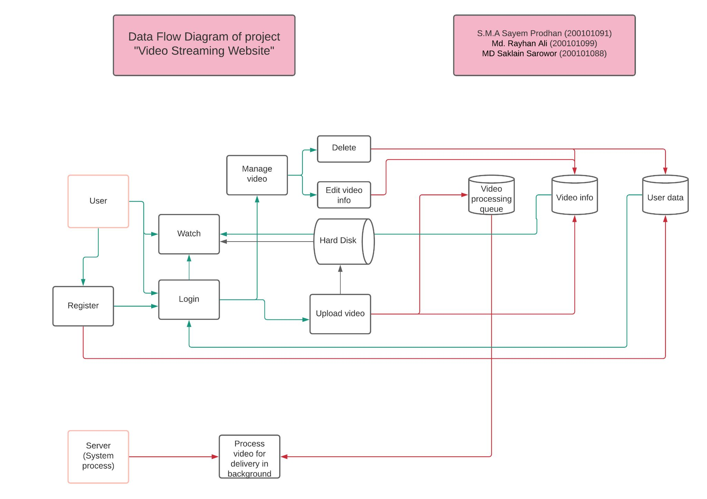
Data Flow Diagram

Slide 5
Details of the working process
Users
In this part a user can perform following action
Create new account
Login
Modify account info
Watch videos (with or without an account)

Slide 6
Details of the working process
Video
This part require a user to have an account and logged in. A user can perform following action
Upload new video
Edit video details
Delete video
Hide video from public

Slide 7
Details of the working process
System
This is an automated process. Here system is referred as the server which can perform following task in background
Process video
  Convert it into an appropriate format to be watched by user
  Create multiple resolutions of the video for smooth delivery
Housekeeping

Slide 8
Work distribution
Everyone will work one a module which touch on all aspects (PHP, Database, HTML, CSS, JS)
99: Video Player, Comments, User Profile
91: Upload, Video Processing
88: Login, Signup

Slide 9
Thank You

